Slide 1

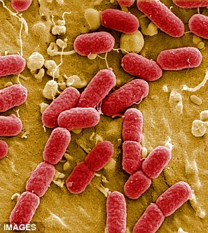
Boolean Network Models in transcriptional regulation and metabolic pathways
Alissa, Aleisha, Aaron

Slide 2
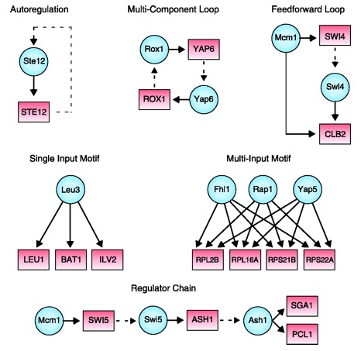
Biological Boolean Network Models:
A directed network graph where each node represents a gene, gene product, or input compound which can be either ‘on’ (1) or ‘off’ (0).
The ‘on’ or ‘off’ state is determined by Boolean functions which use ‘on’/’off’ states of nodes pointing to or inhibiting the node.
Variety of update schemes, methods: truth tables, stochastic models, threshold functions, etc.

Slide 3
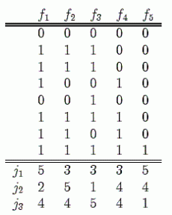
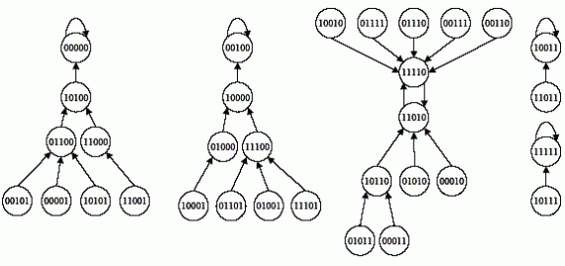
Truth Tables
Can be used to represent proteins via gene expression states.
The expression state of genes are determined by the expression states of previous genes.
There can be 2^X different models that will depend on the genes that are expressed.

Slide 4

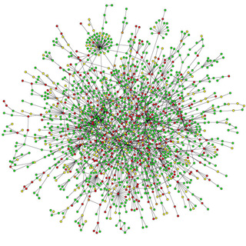
Applications
Cancer research
Signaling network research
In silico models of potential knock out effects
Help run simulations to determine new investigatory pathways

Slide 5
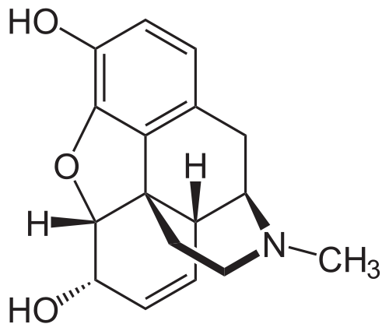
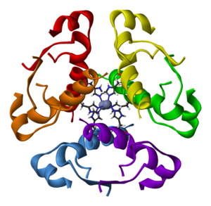
Genetically Modified E. coli:
Medical Modifications
Creation of insulin
Creation of opioids
Creation of vaccines

Slide 6

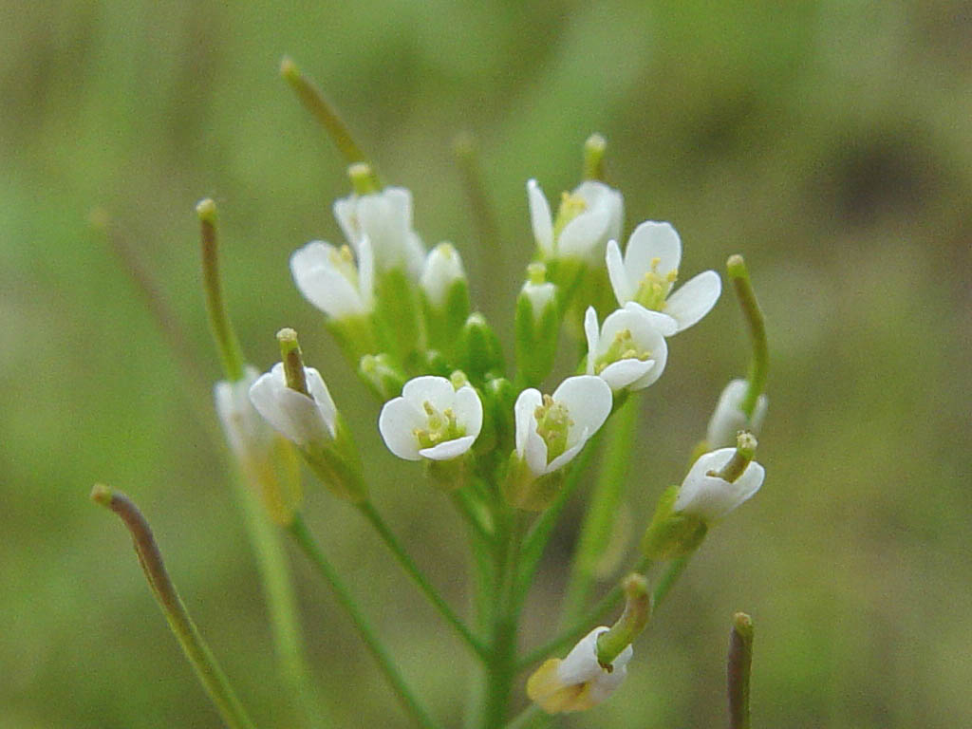
Our pathway: E. coli transgene opiate synthesis
Discovered by Bioengineers at Kyoto University:
Performed modifications to produce opioid precursors.
Enzymes from Opium poppies and genes from other Bacteria Spliced into E. coli:
Coptis Japonica(Opium poppies) – Enzymes added from this plant.
Arabidopsis(Opium poppies) – Enzymes added from this plant.

Slide 7
Our program:
A simplistic Boolean network modeler, able to fulfill the following goals:
Generate Boolean Network graphs
Allow for 1 or 0 state models of a given pathway (in our case, a metabolic pathway) by the user entering nodes, edges, and clarifying any Boolean algebraic issues to the program as it generates truth tables
Run a simulation given a starting vector of node states using simultaneous update scheme and Boolean Functions
Show simulation results in graph form
Allow for file I/O with the models to allow the same network model to be pulled up and re-ran later without complete data re-entry
Allow for ‘overpowered’ nodes to simulate more complex network interactions

Slide 8
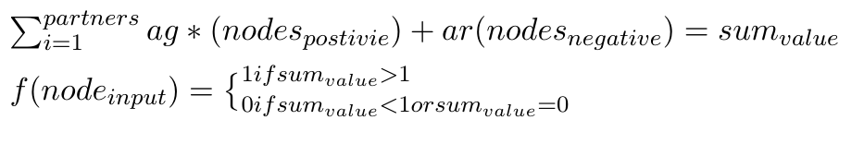
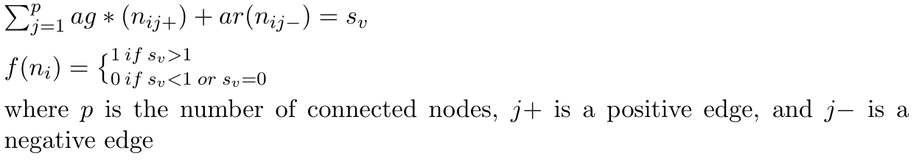
Boolean functions used:

Slide 9
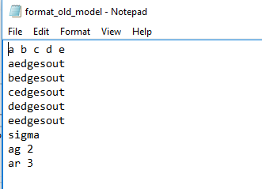
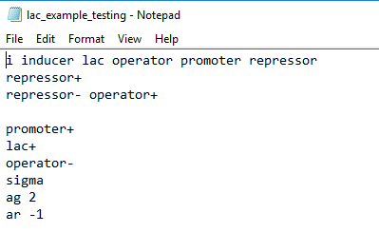
Example Text file:

Slide 10
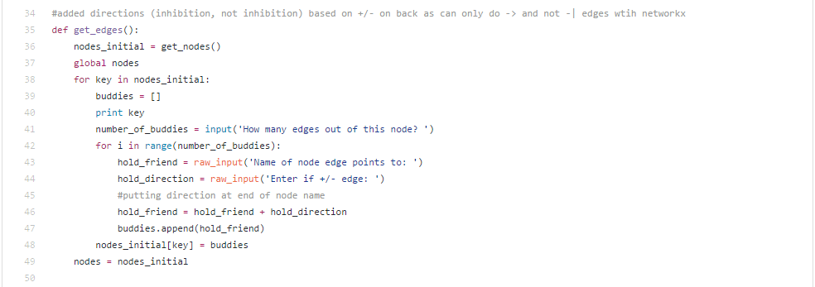
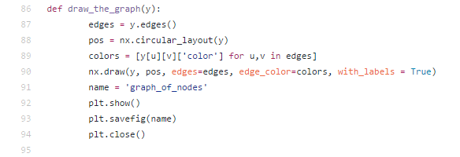
Python code
Libraries we used:
MatPlotLib
NetworkX
Examples from our code:

Slide 11
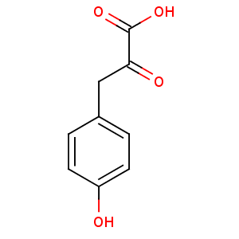
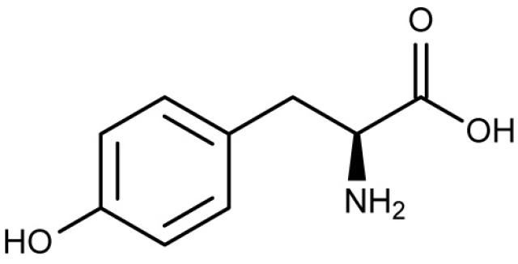
Engineered E. Coli Hydracodone production pathway:
Nodes: 14 Intermediates present in the pathway
Edges: + edges only, as it is assumed that the intermediates will all proceed down the pathway. Edges connect one node to the next in the reaction pathway.
L-tyrosine ----------------------------------→ 4-hydroxyphenyl-pyuruvate

Slide 12
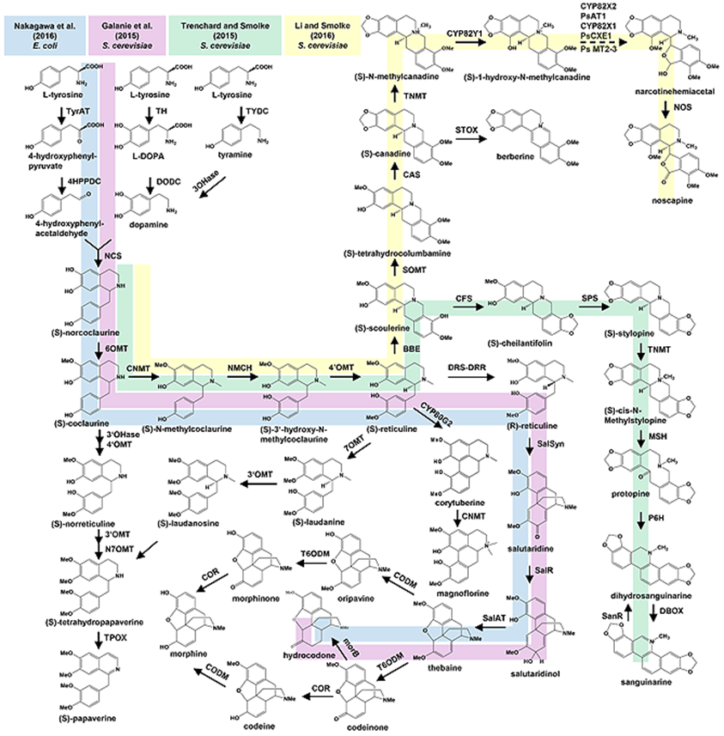

Slide 13

Running a simulation for A small network

Slide 14
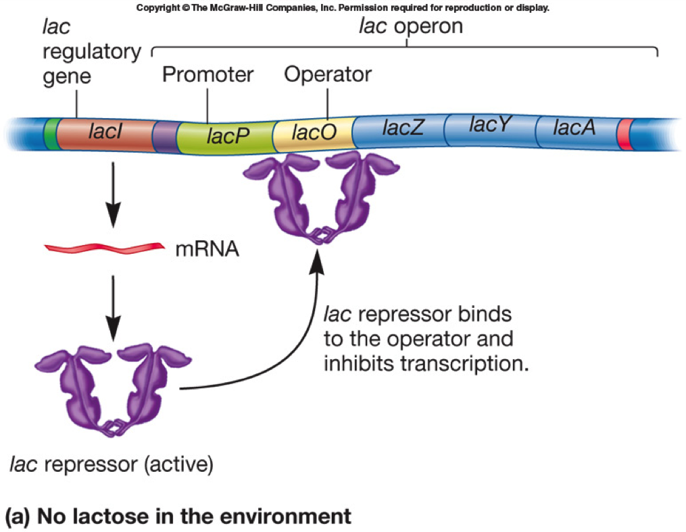
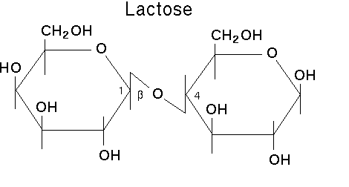
Model of Lac operon:

Slide 15
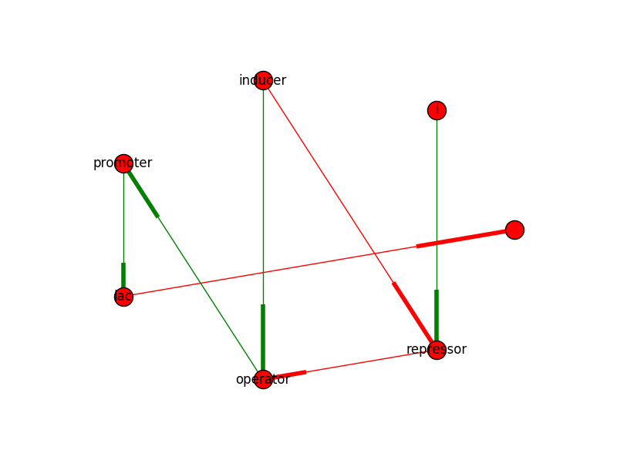
Lac Operon network:

Slide 16
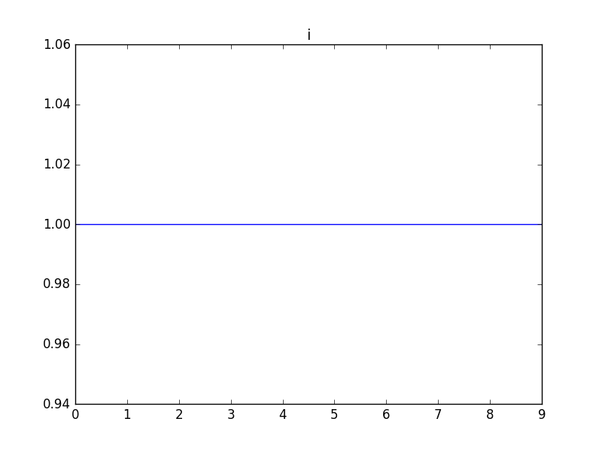
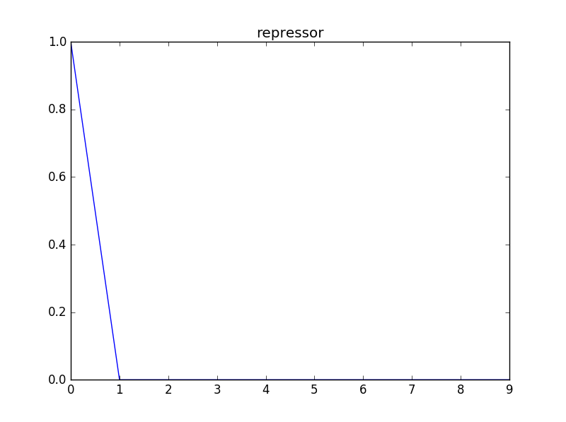
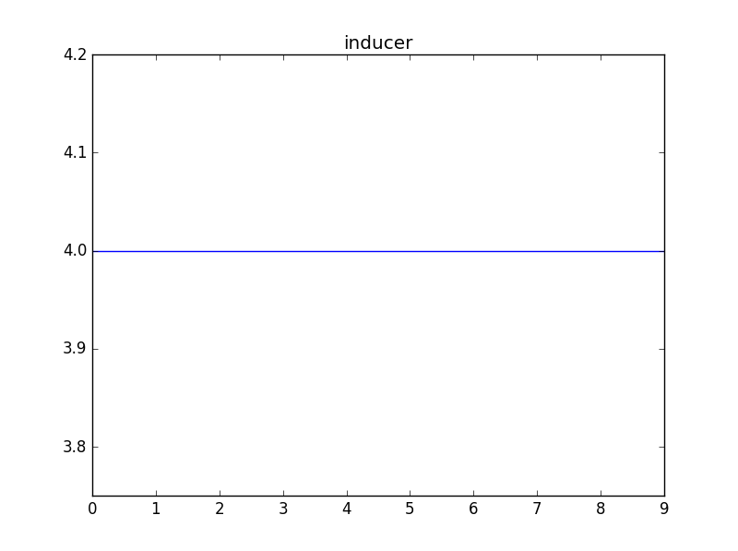
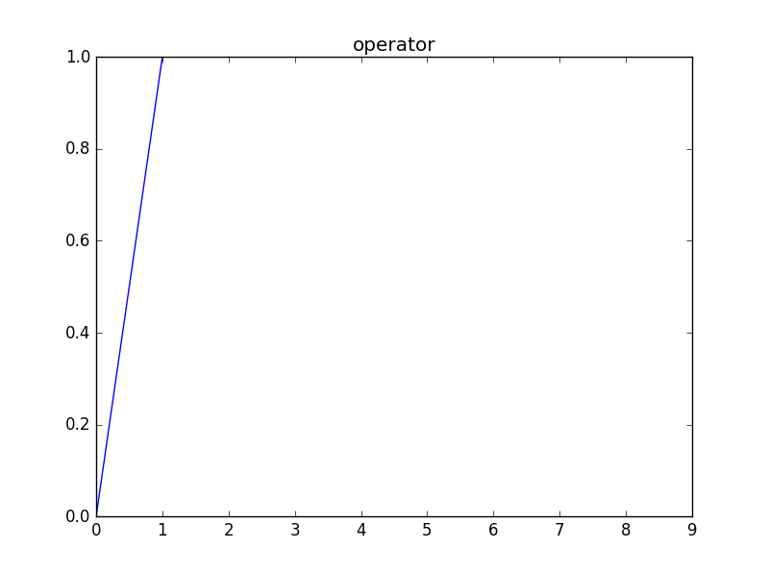
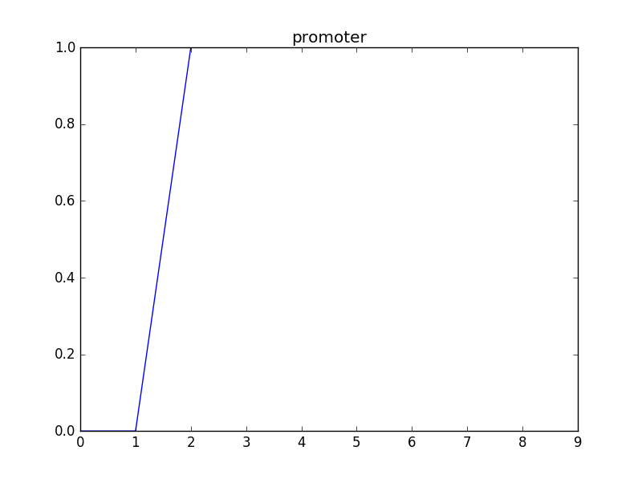
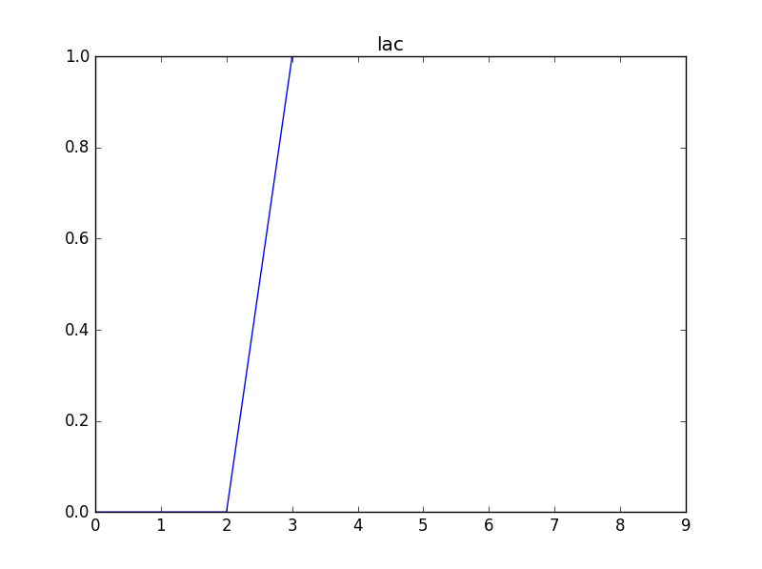
Model results for N=10 generations

Slide 17
modified E. Coli Model

Slide 18
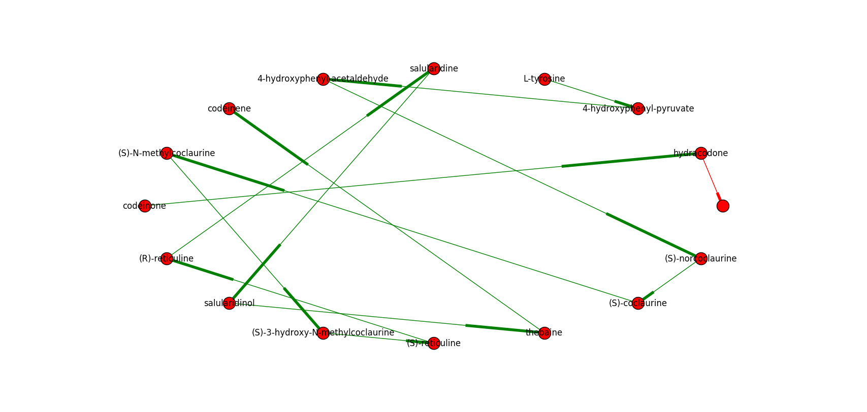
Entering our network:

Slide 19
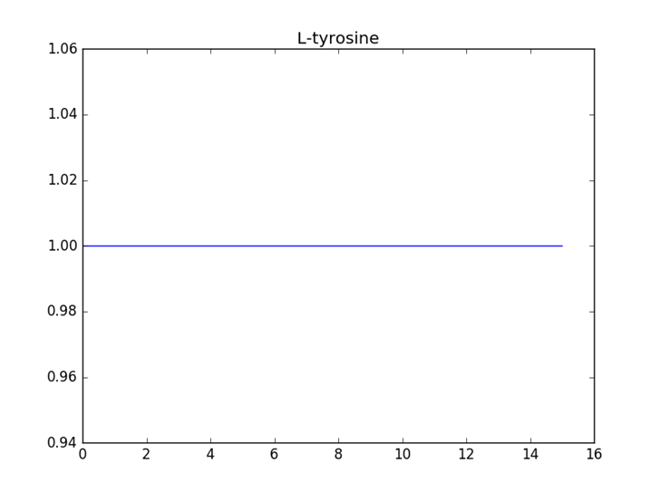
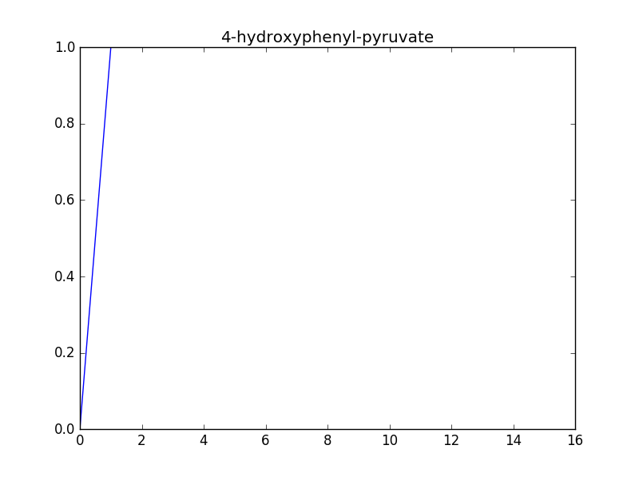

Slide 20
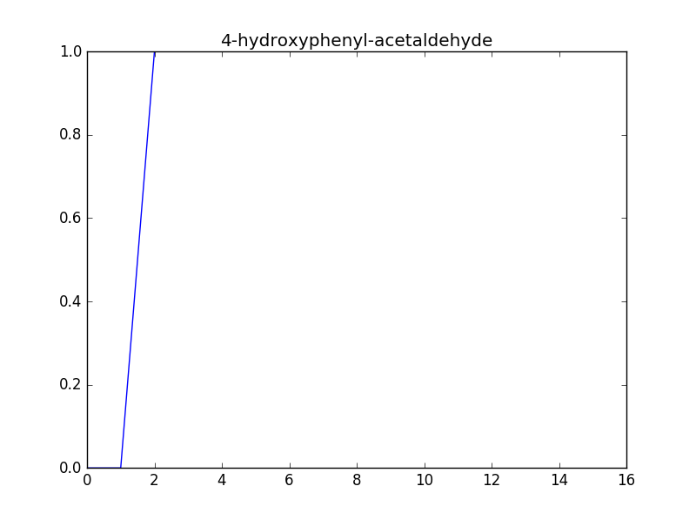
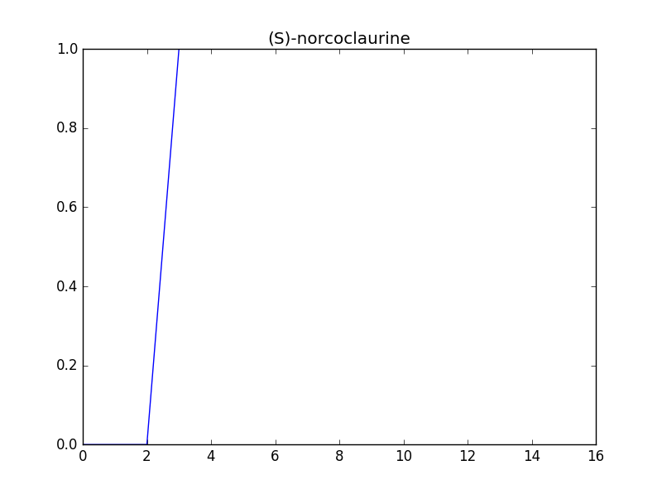

Slide 21
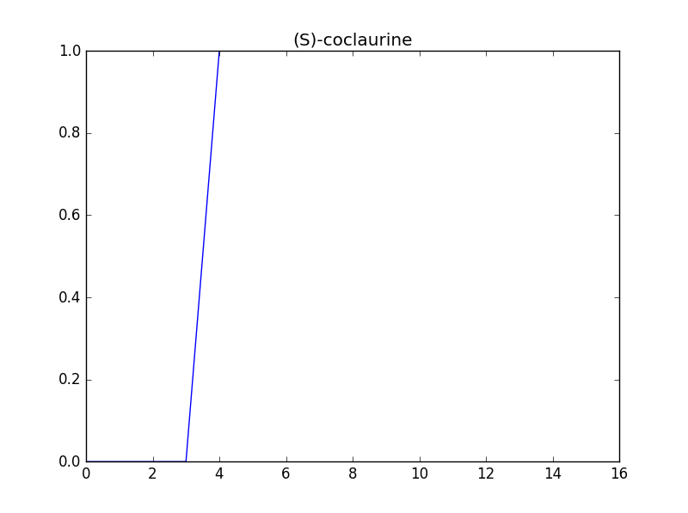
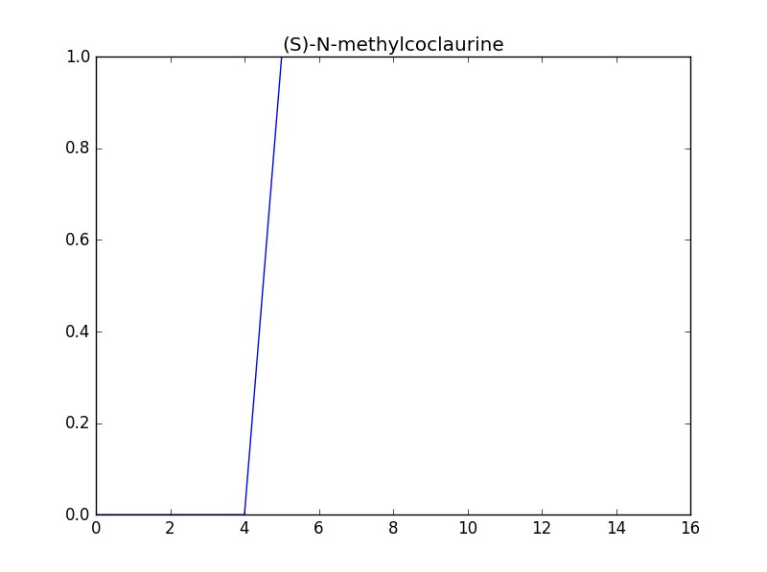

Slide 22
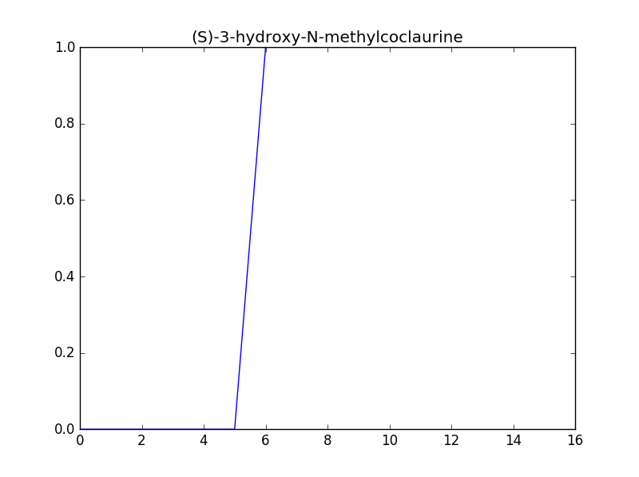
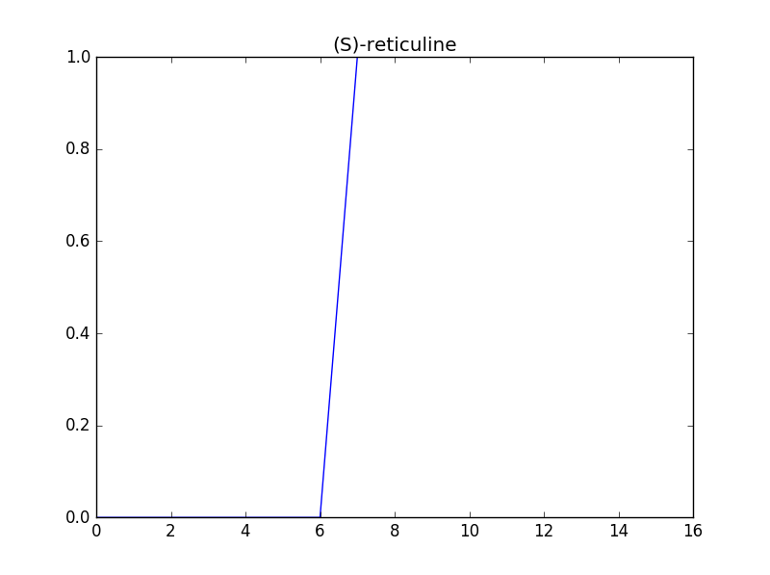

Slide 23
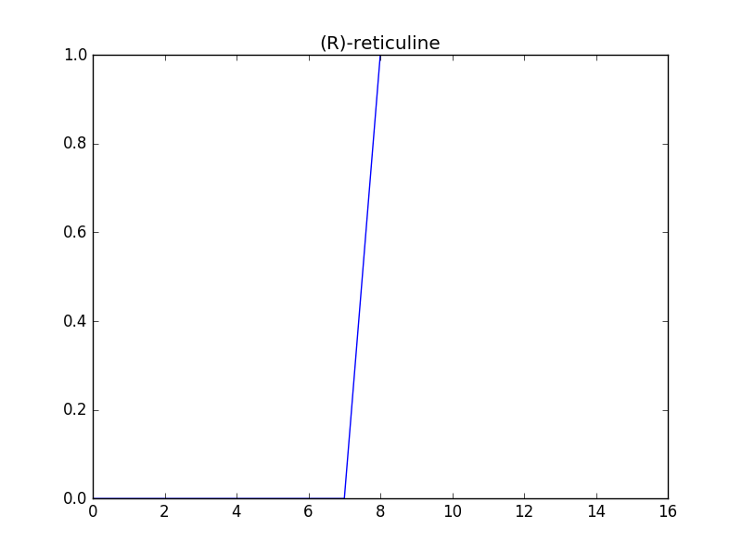
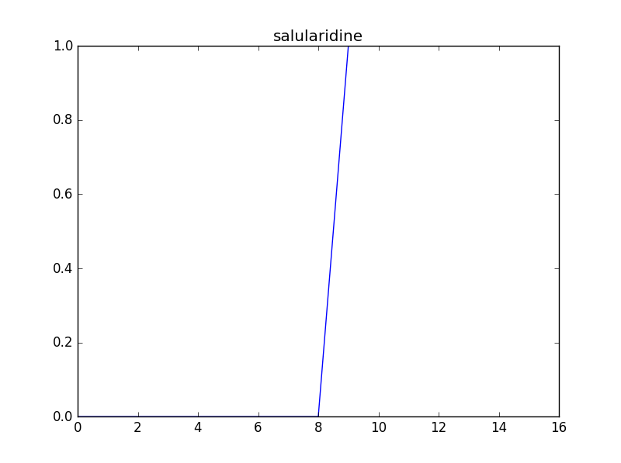

Slide 24
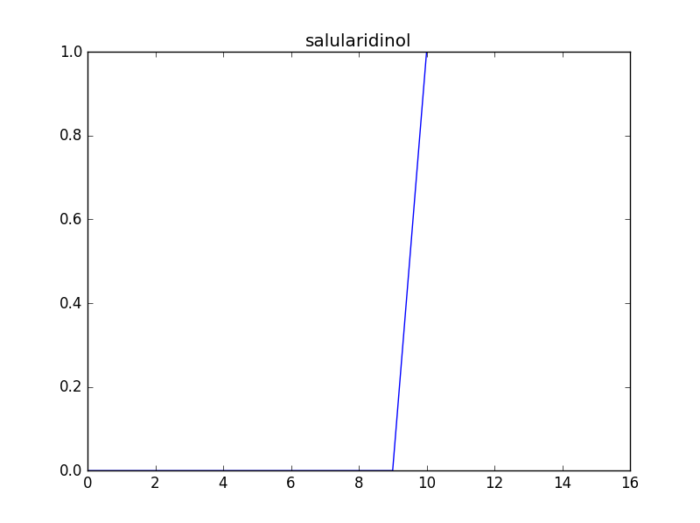
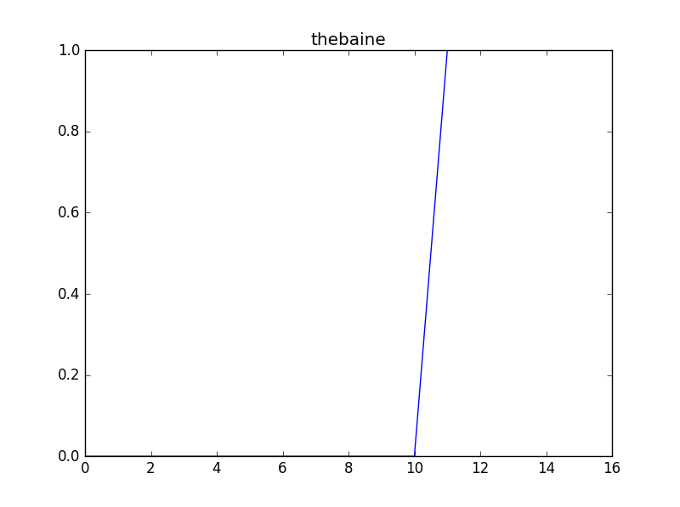

Slide 25
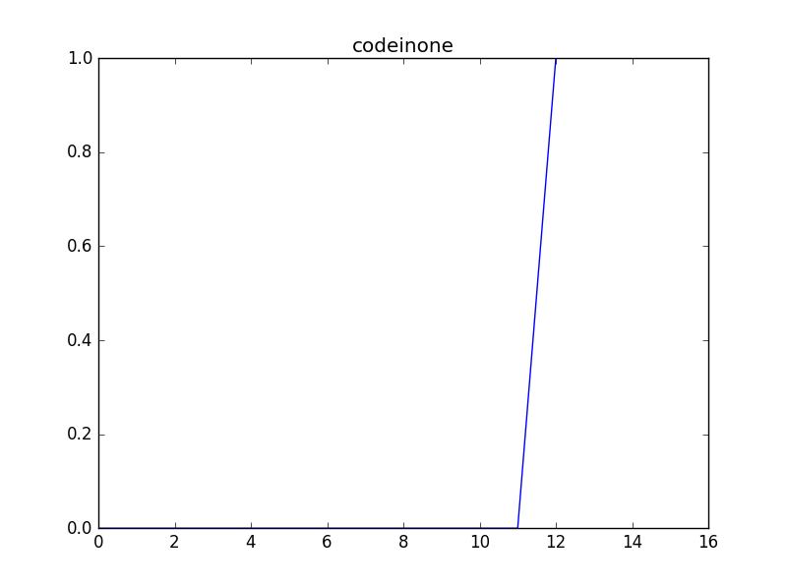
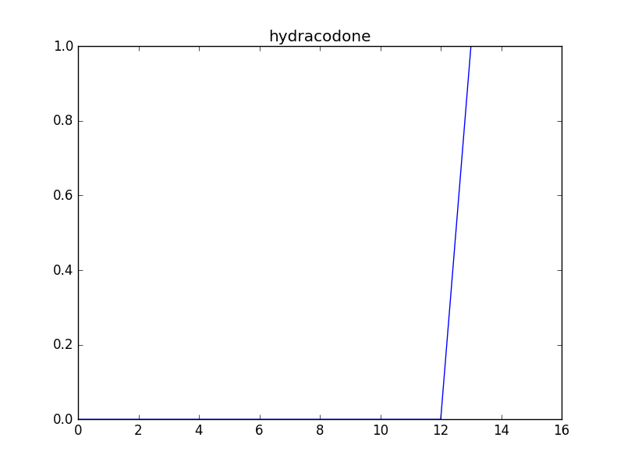

Slide 26
Possible Improvements:
Add in more E. coli metabolic pathways which use common chemical intermediates to make the model more realistic
For example, integrate the model network into already developed E. coli networks which are available in online databases
Allow for asynchronous updating, updating one node slower/faster than others
Allow for mid-model node deletion to model a mutation/defective enzyme
Create own graph generator functions, which can handle self-directed edge visualization in graphs

Slide 27
Sources:
http://www.kyoto-u.ac.jp/en/research/research_results/2015/160205_1.html
http://onlinelibrary.wiley.com/doi/10.1002/biot.201600145/full
http://journals.plos.org/plosbiology/article?id=10.1371/journal.pbio.0050008

